Slide 1

SMART WATER SENSOR
Team members
-Farah Binti Abdul Muttalib
-Mohamad Shahnizam Bin Abd Saini
-Mohamad Syahmi Bin Mohamad Khairudin
-Zulfadli Bin Kamaruzzaman
-Wan Zahiruddin Bin W Abd Kadir
-Muhammad A'tif Bin Abd Razak
-Muhammad Amirul Fahmi Bin Abdullah
-Ahmad Zulzhafri Bin Mohamad Zuki

Slide 2
OBJECTIVES
Implement IoT concept in the project.
Design water level sensor project that use Raspberry Pi as the controller.
Design smartphone apps.
Design webpage using Django framework.
Implement the knowledge of software engineering in the project.

Slide 3
INTRODUCTION
This project functions to read water level at any place where the system being installed such as dam or water tank.
The project can be divided into 3 parts:
Django to create webpage.
Raspberry Pi for the controller.
Smartphone apps.
Webserver and database.

Slide 4
RASBERRY PI

Slide 5





Raspberry Pi GPIO
All Rpi GPIO interaction is setup using Python language
water_system.py
start_pump.py
cleanup.py

Slide 6

Raspberry Pi Webserver
To run Rpi remotely, webserver setup is needed
There are several choices of webserver available
This project using : Apache + PHP

Slide 7
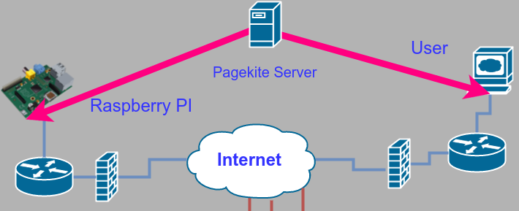
Access Raspberry Pi via Remotely
Webserver setup in Rpi can be publish to the internet for remote access
This project use PageKite as the server to create accessible domain for user

Slide 8
WEBSERVER

Slide 9
Element in Web Server

Slide 10
Data Flow

Slide 11
DJANGO

Slide 12


WEB PAGE DATA FLOW
DATABASE
PHP
PYTHON

Slide 13
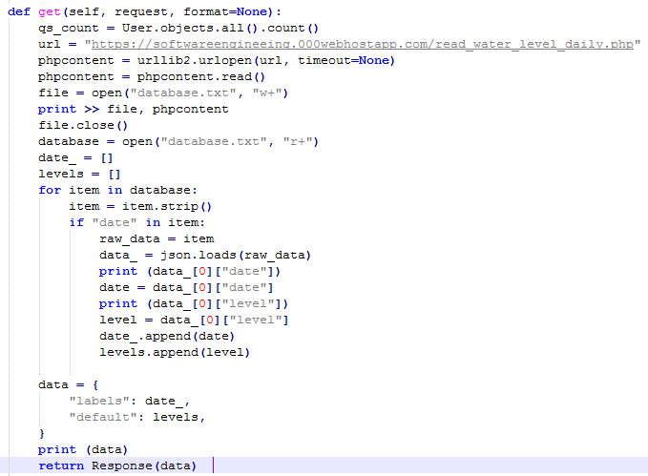
Important Python Code
views.py (extract data from php file)
Package needed: Code:
import json
import urllib2

Slide 14
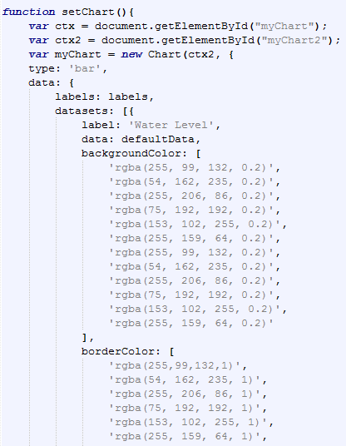
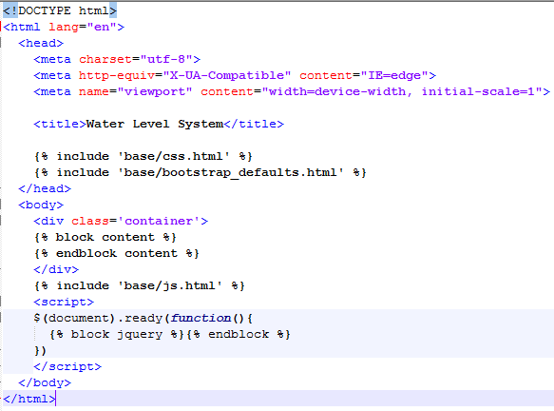
html file for graph specification
chart.html: base.html:

Slide 15
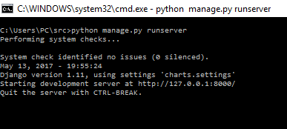
Steps to produce web page
Run the manage.py:
Goto: http://127.0.0.1:8000

Slide 16
ANDROID

Slide 17
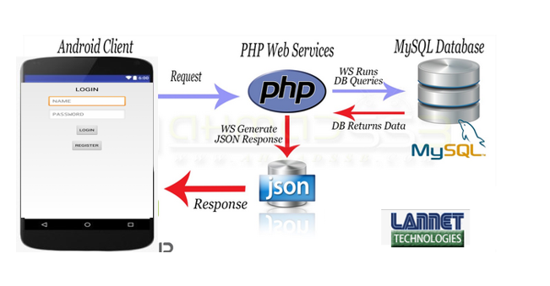
Android app flow ( request & response)
Android apps using android studio software
Java
Login.java
Register.java
Home.java
Xml ( layout)
Login.xml
Register.xml
Home.xml
Php
Init.php
To setup connection to database
Login.php
To send user information and retrieve from database for compare purposes
Register.php
To send and store user information to database
Database MySQL
https://www.000webhost.com
Table
User_info
For login and register
Water_level_detection
For data retrieve

Slide 18
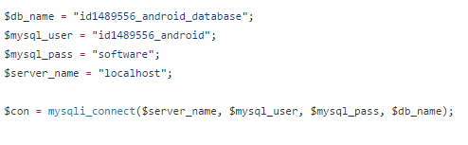

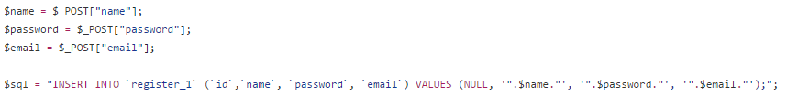
Php file
Init.php
Login.php
Register.php

Slide 19
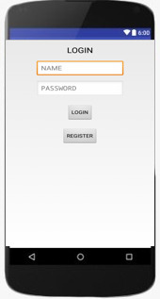
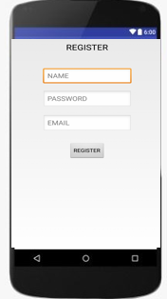
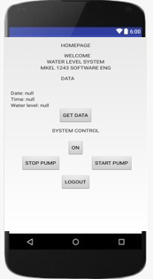
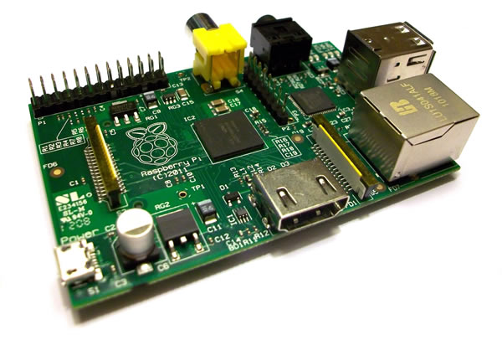
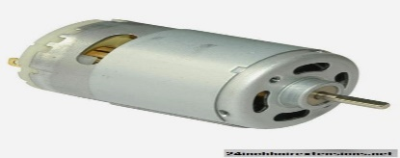
Android app user interface
System Control
ON
START PUMP
STOP PUMP

Slide 20
Backup

Slide 21
Web server
https://softwareengineeing.000webhostapp.com
GitHub
https://github.com/SoftwareEgineeringWaterDetectionSystem/Smart_Water_Level_Detection_System/tree/new-code-update

Slide 22
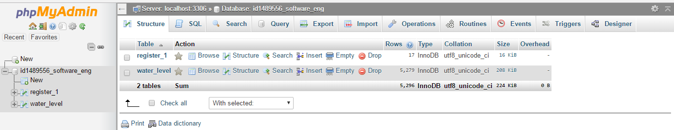
Database

Slide 23
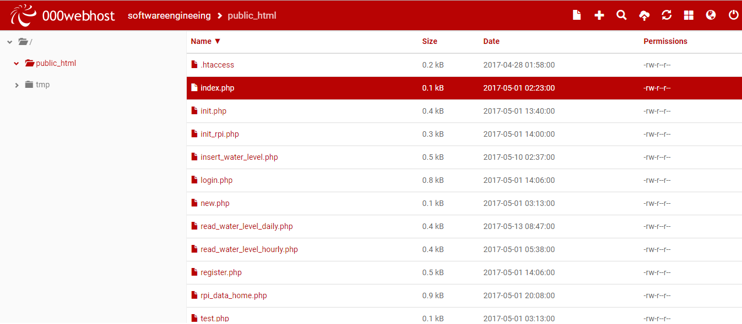
php files

